Slide 1
All-Pairs Shortest Paths
Dynamic-programming algorithms
Floyd-Warshall’s algorithm
Johnson’s algorithm

Slide 2
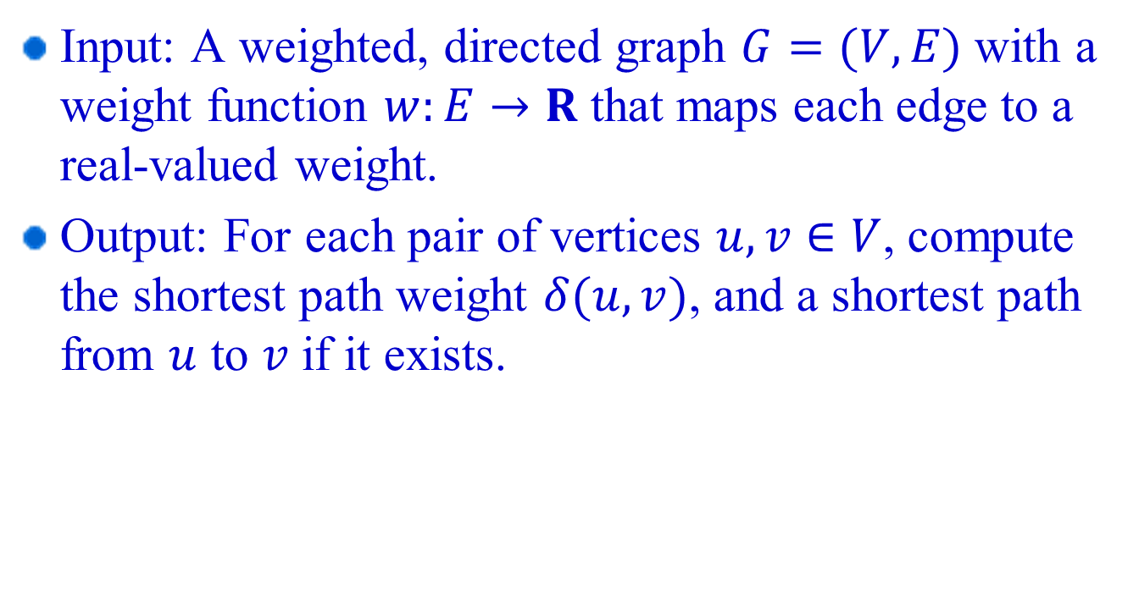
All–pairs shortest paths problem
Input: A weighted, directed graph $G=(V,E)$ with a weight function $w:E→R$ that maps each edge to a real-valued weight.
Output: For each pair of vertices $u,v∈V$, compute the shortest path weight $δ(u,v)$, and a shortest path from $u$ to $v$ if it exists.

Slide 3
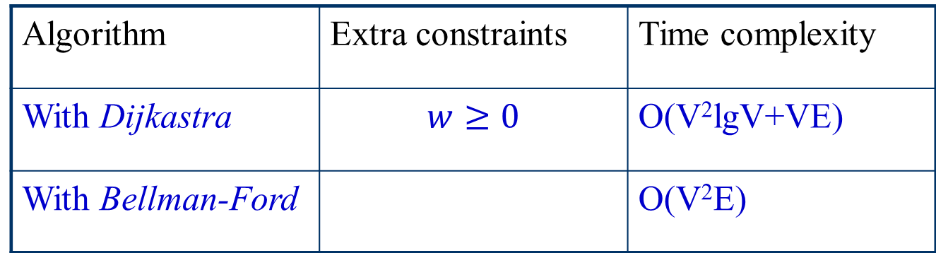
Applying single-source shortest path algorithms
If there are no negative weight edges, Dijkstra’s algorithm can be used, otherwise, Bellman-Ford’s algorithm can be used.
Question: Can we do better? How?
Algorithm | Extra constraints | Time complexity
With Dijkastra | $$w≥0$$ | O(V²lgV+VE)
With Bellman-Ford |  | O(V²E)

Slide 4

All –pairs shortest paths problem
Input: An n $×$n matrix W representing the edges weights of an n-vertex directed graph G=(W, E). That is, W=(w_{ij}), where
Output: An n×n matrix D=(d_{ij}), where d_{ij} denotes the shortest-path weight from vertex i to vertex j, i.e., d_{ij}=δ(i, j).

Slide 5
Dynamic-programming Algorithm
Steps for developing a dynamic-programming algorithm
Characterize the structure of an optimal solution.
Recursively define the value of an optimal solution.
Compute the value of an optimal solution in a bottom-up fashion

Slide 6
Basic Dynamic-programming Algorithm
Suppose there are no negative-weight circles in G
The structure of a shortest-path
All subpaths of a shortest-path are shortest-paths;
Suppose p is a shortest-path from i to j and contains at most m edges;
Then m is finite, since there are no negative weight circles in G;

Slide 7
Basic Dynamic-programming Algorithm
2. Recursive definition of the weight of a shortest-path
Let be the minimum weight of any path from i to j that contains at most edges. Then:

Slide 8
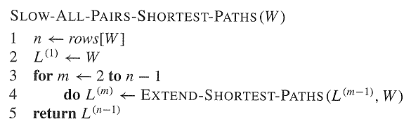
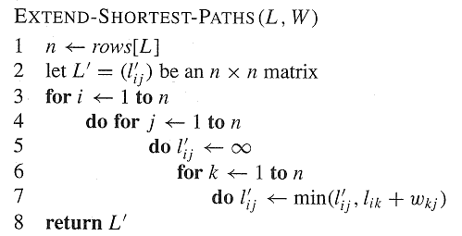
Basic Dynamic-programming Algorithm
3. Computing the shortest-path weights bottom-up

Slide 9
Basic Dynamic-programming Algorithm
Example: Compute L^{(m)}
2
3 4
2
8
1
3
1
-3
4

Slide 10
Improved Dynamic-programming Algorithm
Relation to matrix multiplication

Slide 11
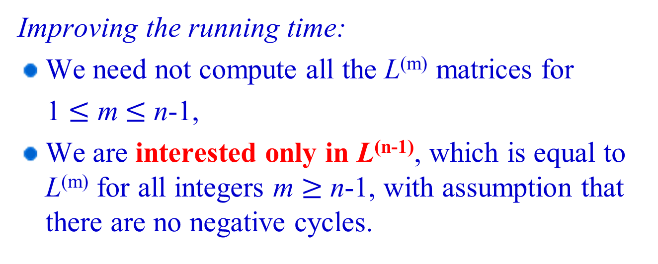
Improved Dynamic-programming Algorithm
Improving the running time:
We need not compute all the L^{(m)} matrices for
1 $≤$ m$≤$ n-1,
We are interested only in L^{(n-1)}, which is equal to L^{(m)} for all integers m $≥$ n-1, with assumption that there are no negative cycles.

Slide 12
Improved Dynamic-programming Algorithm
Compute the sequence
L⁽¹⁾ = W,
L⁽²⁾ = W² = W ⋅ W,
L⁽⁴⁾ = W⁴ = W² ⋅ W²,
L⁽⁸⁾ = W⁸ = W⁴ ⋅ W⁴
...
We need only ⎡lg(n-1)⎤ matrix “products”
Time complexity: O(n³ lg n)

Slide 13
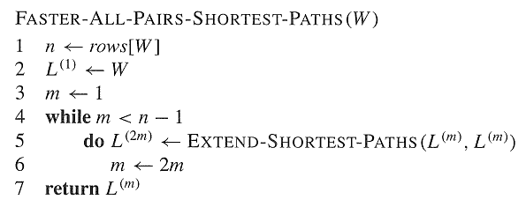
Improved Dynamic-programming Algorithm

Slide 14
Dynamic-programming Algorithm
Steps for developing a dynamic-programming algorithm
Characterize the structure of an optimal solution.
Recursively define the value of an optimal solution.
Compute the value of an optimal solution in a bottom-up fashion
Suppose there are no negative-weight circles in G

Slide 15
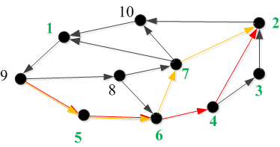

Floyd-Warshall algorithm 1. The structure of a shortest path
intermediate vertex of a simple path.
Consider a subset {1,2,…,k} of vertices for some k. For any pair of vertice i, j∈V:
-case I: there is no path from i to j whose intermediate vertices are all drawn
from {1,2,…,k};
-case II: there are one or more paths from i to j whose intermediate vertices are all
drawn from {1,2,…,k}.
“shortest path” -1: “shortest path” from i to j with constraint that all its
intermediate vertices are in the set {1,2,…,k}.
“shortest path” -2: “shortest paths” from i to j with all intermediate vertices
in the set {1,2,…,k-1}.
What’s the relationship between these two types of “shortest path”?
Weight of each edge = 1

Slide 16
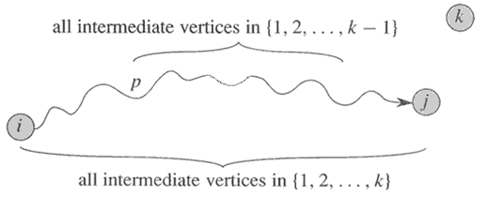
Floyd-Warshall algorithm 1. The structure of a “shortest path”
case 1: k is not an intermediate vertex of path p;
Observation: A “shortest path” from vertex i to vertex j with all intermediate vertices in the set {1,2,…,k-1} is also a “shortest path” from i to j with all intermediate vertices in the set {1,2,…,k}.

Slide 17
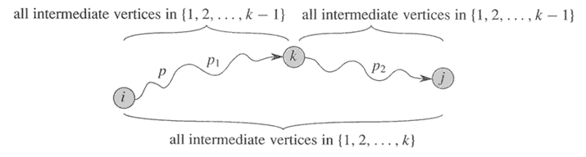
Floyd-Warshall algorithm 1. The structure of a “shortest path”
case 2: k is an intermediate vertex of path p;
Observation: p can be broken down into two parts p₁ and p₂. p₁ is a “shortest path” from vertex i to vertex k with all intermediate vertices in the set {1,2,…,k} and is also a “shortest path” from i to k with all intermediate vertices in the set {1,2,…,k-1}. Similarly, p₂ is a “shortest path” from k to j with all intermediate vertices in the set {1,2,…,k-1}.

Slide 18
Floyd-Warshall algorithm 2. A recursive solution to the all-pairs shortest-paths problem
d_{ij}^{(k)}: “shortest path” weight from i to j with intermediate vertices in the set {1,2,…,k}.
Because for any path, all intermediate vertices are in the set {1,2,…,n}, the matrix gives the final answer:

Slide 19
Floyd-Warshall algorithm 3. Computing the shortest-path weights
Compute D⁽⁰⁾ (=W)
D⁽¹⁾
D⁽²⁾
…
D^{(n)}

Slide 20
Floyd-Warshall algorithm
$$k=1:d_{42}^{ (1)}=5; d_{43}^{ (1)}=−5;d_{45}^{ \left(1\right)}=−2$$
2
3
4
1
3
8
-4
2
1
-5
7
5
4
6

Slide 21
Floyd-Warshall algorithm
$$k=2:d_{42}^{ (2)}=5; d_{43}^{ (2)}=−5;d_{45}^{ \left(2\right)}=−2$$
2
3
4
1
3
8
-4
2
1
-5
7
5
4
6

Slide 22
Floyd-Warshall algorithm
$$k=3:d_{42}^{ (3)}=−1; d_{43}^{ (3)}=−5;d_{45}^{ \left(3\right)}=−2$$
2
3
4
1
3
8
-4
2
1
-5
7
5
4
6

Slide 23
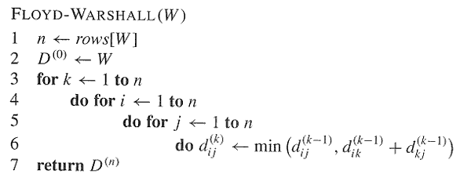
Floyd-Warshall algorithm

Slide 24

Floyd-Warshall algorithm
Time complexity: $O(n^{3})$

Slide 25
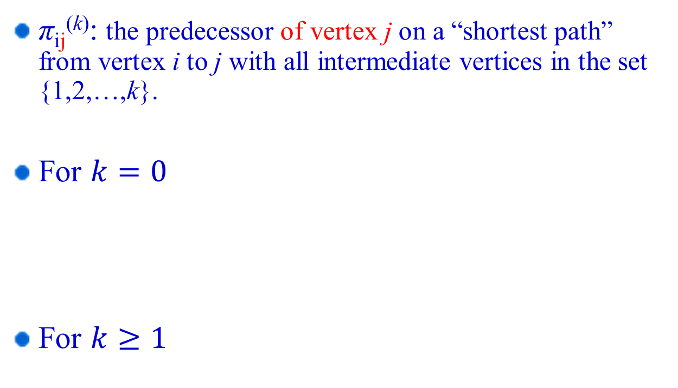
Constructing a shortest path
π_{ij}^{(k)}: the predecessor of vertex j on a “shortest path” from vertex i to j with all intermediate vertices in the set {1,2,…,k}.
For $k=0$
For $k≥1$

Slide 26
Constructing a shortest path
Compute ∏⁽⁰⁾
∏⁽¹⁾
∏⁽²⁾
…
∏^{(n)}

Slide 27
Example:
2
4
3
1
3
8
1
-4
-5
7
2
5
4
6

Slide 28
D(0)=
(0)=
D(1)=
(1)=

Slide 29
D(2)=
(2)=
D(3)=
(3)=

Slide 30
D(4)=
(4)=
(5)=
D(5)=

Slide 31
Shortest path from 1 to 2 in
2
4
3
1
3
8
1
-4
-5
7
2
5
4
6

Slide 32
Transitive closure of a directed graph
Transitive closure of a graph G=(V, E) is defined as the graph G* = (V, E*), where
E* = {(i, j): there is a path from i to j in G}
Problem: For any pair of vertices i and j, find out whether there is a path from i to j and compute G* = (V, E*).
a
c
b
i
j

Slide 33
Transitive closure
One way:
set w_{ij} = 1 and
run the Floyd-Warshall algorithm, if d_{ij}^{(n)}<∞, then there is a path from i to j in G, add (i, j) to E*,
running time O(n³)

Slide 34
Transitive closure
Another way:
t_{ij}^{(k)}: indication whether there is a path from i to j with intermediate vertices in the set {1,2,…,k}.
substitute “+” and “min” by and in Floyd-Warshall’s algorithm
running time O(n³)

Slide 35
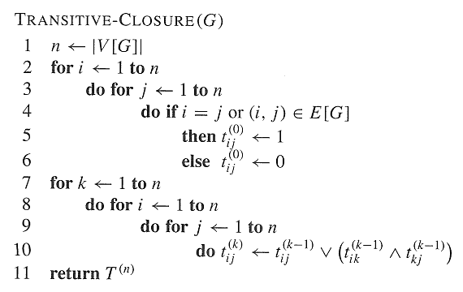
Transitive closure

Slide 36
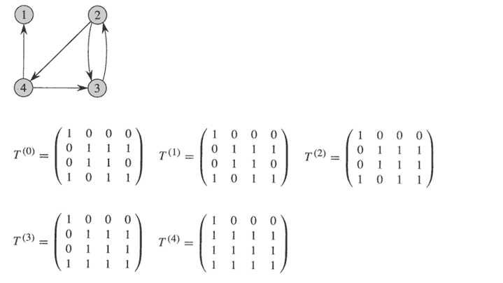
Transitive closure

Slide 37
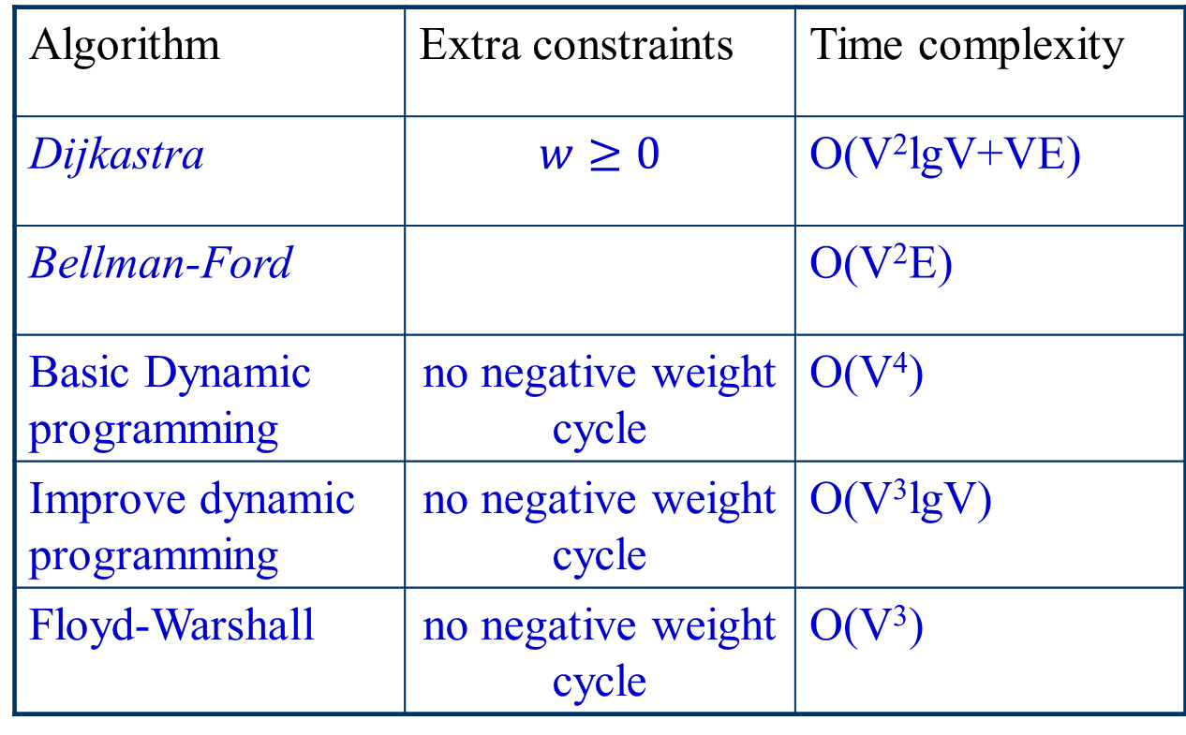
All-pairs shortest paths problem algorithm comparison
Algorithm | Extra constraints | Time complexity
Dijkastra | $$w≥0$$ | O(V²lgV+VE)
Bellman-Ford |  | O(V²E)
Basic Dynamic programming | no negative weight cycle | O(V⁴)
Improve dynamic programming | no negative weight cycle | O(V³lgV)
Floyd-Warshall | no negative weight cycle | O(V³)

Slide 38
Johnson’s algorithm (idea)
If (all edge weights are non-negative)
Invoke Dijkastra’s algorithm V times,
else if (there are negative weight edges but no negative weight cycles)
Reweight graph so that
all edge weights are non-negative, and that
shortest path does not change after reweighting
Invoke Dijkastra’s algorithm for each vertex as
source.
* Time Complexity: O(V²lgV+VE)
* If G is sparse, better than Fload-Warshall’s algorithm

Slide 39

Reweighting Technique (I)
Lemma 25.1 (reweighting does not change shortest paths):
Given a weighted,directed graph G=(V,E) with weight function w. Let $h:V→R$ be any function. For each edge (u,v)∈E, define
ŵ(u,v) = w(u,v) + h(u) - h(v)
Let p=<v₀,…,v_{k}> be a path from v₀ to v_{k}. Then p is a shortest path using weight function w if and only if it is a shortest path using weight function ŵ. Also, G has a negative-weight cycle with w if and only if G has a negative-weight cycle with ŵ.
Proof: 1. For any path p from v₀ to v_{k}, we have
ŵ(p)=w(p)+h(v₀)-h(v_{k}),
so, a path from v₀ to v_{k} is shortest with w if and only if it is shortest with ŵ.
2. Consider any cycle C=<v₀,…,v_{k}>, we have
ŵ(C) = w(C)+h(v₀)-h(v₀) = w(C),
G has a negative cycle with w if and only if it has a negative cycle with ŵ.

Slide 40
Reweighting Technique (II)
Producing nonnegative weights by reweighting
Given a weighted, directed graph G = (V, E) with w, we make a new graph G’ = (V’,E’), where V’ = V∪{s}, s is not in V, and E’ = E∪{(s,v) : v is in V}. w(s,v) is set 0, for all v in V.
0
10
-5
10
-5
4
4
8
0
8
-6
-6
s
0
7
9
7
9
0
2
2
0

Slide 41
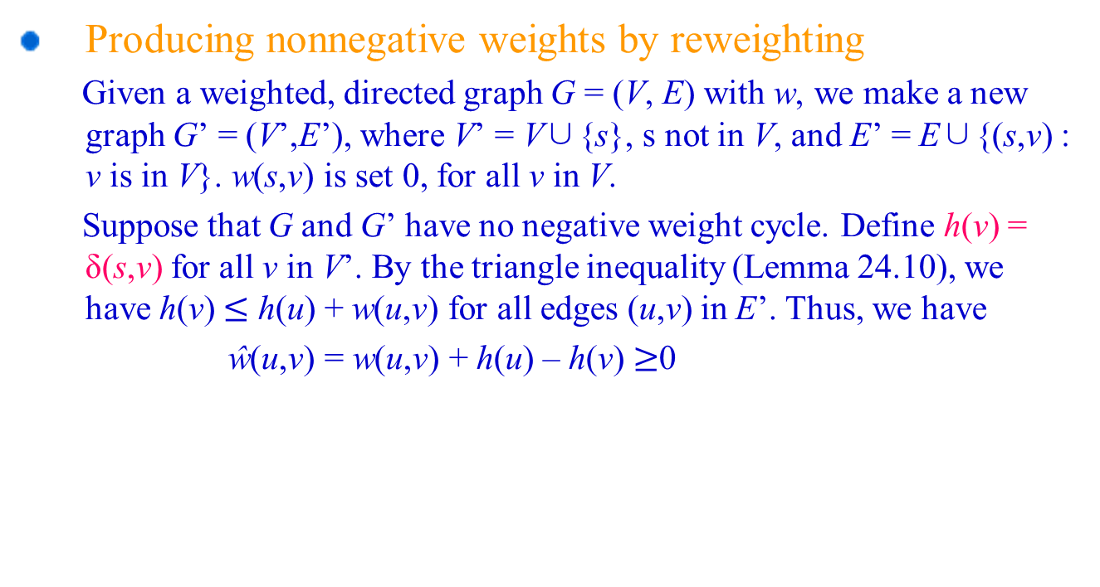
Reweighting Technique (II)
Producing nonnegative weights by reweighting
Given a weighted, directed graph G = (V, E) with w, we make a new graph G’ = (V’,E’), where V’ = V∪{s}, s not in V, and E’ = E∪{(s,v) : v is in V}. w(s,v) is set 0, for all v in V.
Suppose that G and G’ have no negative weight cycle. Define h(v) = δ(s,v) for all v in V’. By the triangle inequality (Lemma 24.10), we have h(v) $≤$ h(u) + w(u,v) for all edges (u,v) in E’. Thus, we have
ŵ(u,v) = w(u,v) + h(u) – h(v) $≥$0

Slide 42
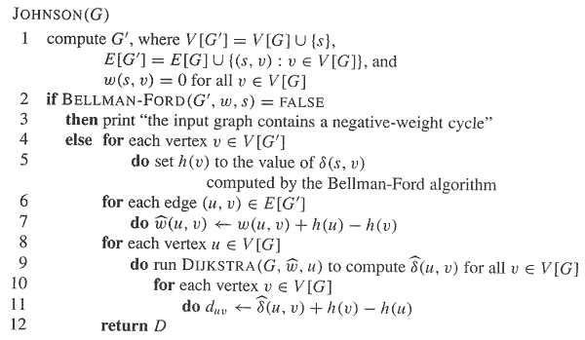
Johnson’s algorithm

Slide 43
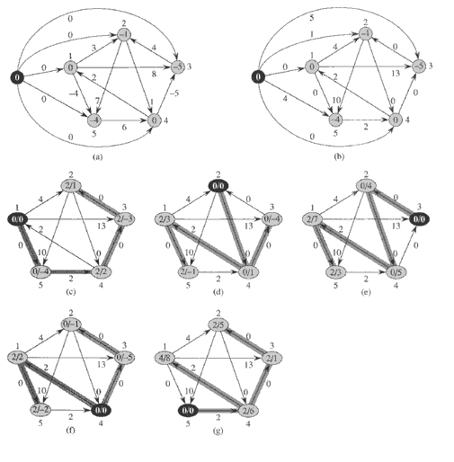
Johnson’s Algorithm (example)

Slide 44
Johnson’s algorithm
Time complexity:
Compute G’: O(V+E)
Bellman-Ford: O(VE)
Re-weighting: O(E)
Dijkastra’s: O(VlgV+E)
Total: O(V²lgV+VE)
If G is sparse, e.g., E=O(V), then better than Floyd-Warshall.

Slide 45
Table of running times
algorithm | running time
Dijkstra‘s | O(V² lg V+VE)
Bellman-Ford | O(V²E)
Basic Dynamic programming | O(V⁴)
Improve dynamic programming | O(V³ lg V)
Floyd-Warshall | O(V³)
Johnson‘s Transitive closure | O(V² lg V+VE) O(V³)

